Slide 1



Portfolio Optimization Based on Uncertainty Theory
A Mean-Chance Model with Background Risk, Liquidity, and Trading Constraints
4th International Conference on Computational Finance and Business Analytics (CFBA) 2026
Speaker: Jingwen Ju| Duration: 15 minutes
Notes:
Hello everyone, I'm [Your Name]. Today, I will present a study on portfolio optimization. As we all know, traditional portfolio theory has many limitations in practical applications. This research aims to construct a more realistic model by introducing uncertainty theory, integrating background risk, liquidity, and transaction costs, to provide investors with a better decision-making framework. Next, I will introduce from four aspects: research background, methodology, results, and conclusions.

Slide 2
Outline | Research Agenda
01 Introduction & Purpose
02 Methodology & Process
03 Results & Analysis
04 Conclusion
Notes:
本次报告将分为四个部分。首先，我将介绍研究的背景、目的以及我们试图解决的核心问题。其次，我会详细阐述我们所采用的研究方法，包括理论框架和模型构建过程。第三部分，我将展示我们的主要研究结果，包括理论分析和数值模拟的发现。最后，我将对整个研究进行总结，并探讨其理论与实践意义。

Slide 3



01 Introduction & Purpose
Research Background and Motivation
To address the efficiency bottlenecks and data silo issues currently faced by the industry, and in alignment with business development strategy requirements, this study aims to explore new pathways enabled by technological empowerment to respond to challenges arising from evolving market environments.
Core Research Objectives
1. Identify the root causes and influencing factors of key issues;
2. Validate the feasibility and effectiveness of proposed solutions in real-world scenarios;
3. Provide data support and theoretical basis for subsequent product iterations or business decisions.
Key Insight: 清晰的目标界定是确保研究方向正确与产出价值的基石。
Notes:
现在，我们进入第一部分：引言与目的。在这一部分，我们将探讨为什么需要进行这项研究，以及我们希望通过这项研究达成什么样的目标。

Slide 4



Research Background: Limitations of Traditional Portfolio Theory
Ignoring Non-tradable Risks (Background Risk)
Traditional models often overlook non-financial asset risks faced by investors, such as labor income stability and real estate value fluctuations, leading to a disconnect between theoretically optimal allocations and real-world risk tolerance.
Detachment from Market Realities and Frictional Costs
Idealistically assuming zero transaction costs and perfect liquidity, they fail to adequately consider bid-ask spreads, minimum trading unit constraints, and liquidity risks, making them difficult to directly guide actual high-frequency trading operations.
Reliance on Historical Data and Prediction Bias
Model parameter calibration heavily relies on historical return data. In scenarios with sparse data samples or structural market mutations (e.g., financial crises), predictive power drops significantly, and there is a lack of mechanisms to integrate expert subjective judgments.
Notes:
Modern Portfolio Theory (MPT) is the cornerstone of financial decision-making. However, it has significant limitations. First, it ignores non-tradable risks, known as background risks, faced by investors. Second, many models are detached from market realities, failing to account for transaction costs, liquidity, and other practical constraints. Finally, they heavily rely on historical data, which becomes problematic when data is insufficient or market conditions change. These limitations provide the entry point for our research.

Slide 5

Problem Statement: Gaps in Existing Research
Fragmented Research on Background Risk
Most studies are based on the traditional probability theory framework, focusing on the calculation of objective probabilities, making it difficult to effectively quantify and handle subjective uncertainty factors in real-world decision-making.
Insufficient Application of Uncertainty Theory
Insufficient Breadth:Existing models do not deeply explore the underlying impact mechanism of the volatility of background risk itself on decision outcomes.
Simplified Constraints:The modeling of real market frictions such as liquidity constraints and transaction costs is too idealized and simplified.
Low Model Integration:Lack of a unified framework, making it difficult to simultaneously consider complex real-world constraints and the uncertainty characteristics of background risk.
Notes:
Although existing studies have begun to focus on these issues, there are still obvious gaps. On the one hand, most research on background risk is based on probability theory, making it difficult to handle subjective uncertainty. On the other hand, while uncertainty theory provides new tools, existing models either do not analyze background risk in sufficient depth or overly simplify the modeling of real-world constraints, lacking a unified framework that can integrate multiple factors.

Slide 6
Research Objectives and Core Contributions
01 Developing an Integrated Model
Develop a new "Uncertainty Mean-Opportunity Portfolio Model", integrating background risk with multiple realistic constraints such as liquidity, transaction costs, and minimum transaction units into a unified framework for the first time.
02 Improving Risk Measurement
Introduce chance constraint theory to measure liquidity risk, accurately matching the real needs of risk-averse investors for extreme loss control.
03 Revealing the Actual Impact of Background Risk
Systematically quantify the dynamic impact mechanism of background asset volatility on the expected return of optimal portfolios and capital allocation strategies.
Notes:
To address these gaps, our research objectives are clear. First, we propose an integrated model that unifies background risk with multiple realistic constraints into a single framework for the first time. Second, we use chance constraints to improve the measurement of liquidity risk, making it more aligned with investors' actual behavior. Finally, through our research, we aim to systematically reveal how the volatility of background risk affects investment decisions, providing new insights for investors.

Slide 7
02 Methodology and Main Process
01 Research Design and Hypothesis
Construct a theoretical framework based on research objectives, clarify the relationships between core variables, and establish testable scientific hypotheses.
02 Data Collection and Preprocessing
Collect multi-dimensional sample data, and construct a high-quality dataset through cleaning, normalization, and feature engineering.
03 Model Construction and Solution
Design the algorithm model architecture, configure parameters for iterative training, and complete the numerical solution and optimization of core problems.
Notes:
Next, we move to the second part, introducing our research methodology and main process. In this section, I will explain in detail how we constructed the model and solved it.
First, in the research design phase, we established core hypotheses based on the theoretical framework and clarified the causal relationships between variables.
Second, we did a lot of preparation work at the data level, including the collection of multi-source data and strict preprocessing to ensure the quality of input data.
Finally, the focus is on the model construction and solution phase. We adopted a specific algorithm architecture and after multiple rounds of iterative optimization, we finally obtained reliable solution results.

Slide 8



Theoretical Framework and Model Construction: Portfolio from an Uncertainty Perspective
▍Theoretical Framework: Uncertainty Theory
Breaking through the limitations of traditional probability theory, asset returns are regarded asuncertain variableswhose distributions are determined by expert credibility. This provides a rigorous mathematical tool for investment modeling in scenarios with insufficient data or reliance on subjective judgments.
▍Model Construction: Analysis of Core Elements
Objective Function:Maximize the expected total return of the investment portfolio including background risk.
Decision Variables:Trading units of risky assets (xi), amount of risk-free assets (xf).
Uncertain Variables:Asset return rate (ri), background asset return rate (rb), turnover rate (ti).
Notes:
The theoretical basis of our research is uncertainty theory. Unlike traditional probability theory, this theory treats variables such as asset returns as uncertain variables whose distributions are determined by expert credibility, making it very suitable for handling scenarios with insufficient data or reliance on subjective judgments.
Based on this, we have constructed a model to maximize the expected total return, which includes multiple core elements such as risky assets, risk-free assets, background risk, and liquidity, specifically involving the setting of three dimensions: objective function, decision variables, and uncertain variables.

Slide 9
Key Constraints of the Model
1. Return Risk Constraint (Chance Constraint I)
Formula: M{Rp ≤ a} ≤ α | Ensure the risk of underperformance is controlled
2. Liquidity Risk Constraint (Chance Constraint II)
Formula: M{Lp ≥ b} ≥ β | Ensure sufficient liquidity at high confidence levels
3. Budget Constraint
Principle: Total Investment + Transaction Costs = Initial Wealth | Strictly match initial capital
4. Trading Constraints
Details: Set position size limits and minimum trading units (integer constraints) to reflect market reality
Notes:
Our model incorporates four key real-world constraints. The first two are chance constraints, designed to control the risk of underperformance and ensure the portfolio has sufficient liquidity. These better reflect risk aversion than traditional expectation constraints. Additionally, we have included standard budget constraints and trading constraints with minimum transaction units, making the model more realistic.

Slide 10

Model Solution: Deterministic Equivalent Transformation
01. Equivalent Transformation under General Distribution (Theorem 1)
Under general uncertainty distribution, the original uncertain programming model is transformed into its correspondingdeterministic equivalent modelthrough mathematical derivation to eliminate the influence of random variables.
02. Simplified Solution under Normal Distribution (Theorem 2)
Assuming all uncertain variables follow anormal uncertain distribution, a specific and directly computable deterministic equivalent model can be further simplified, reducing the complexity of solving.
03. Numerical Solution and Tool Implementation
Using the transformed deterministic model, theMATLABOptimization Toolbox is employed for numerical solution to efficiently obtain the optimal decision scheme.
Notes:
To solve this complex uncertain model, we performed key mathematical derivations. Through Theorems 1 and 2, we successfully transformed the original model into its deterministic equivalent. Especially after assuming the variables follow a normal uncertain distribution, the model becomes very easy to compute. Finally, we used standard optimization tools like MATLAB to solve this model.

Slide 11
03 Results and Analysis
Results and Analysis
Theoretical Verification Reconstructing the logical framework based on mathematical derivation to verify the stability and consistency of the model under extreme conditions.
Simulation Outcomes Presenting data comparisons from multiple variable-controlled experiments to intuitively show the influence trend of parameter changes on results.
Insight into the Mechanism Revealing the core dynamic mechanisms hidden behind experimental phenomena through data fitting and feature extraction.
Notes:
Now we enter the third part, presenting our research results and analysis. This section will verify our model and reveal its internal mechanisms through theoretical derivation and numerical simulation.

Slide 12

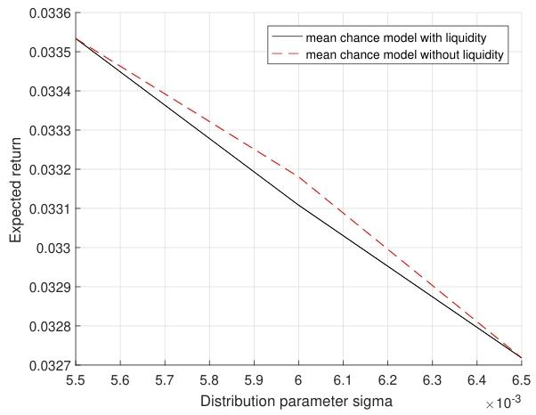


Theoretical Analysis: Mechanism of Background Risk's Impact on Portfolio
Theorem 3 & 4: Negative Correlation between Return and Risk
As the background risk standard deviation (σ_b) increases, the expected return of the optimal portfolio exhibits a monotonically decreasing trend, with higher volatility leading to lower returns.
Corollary 1: Optimality of No Background Risk
A portfolio constructed without accounting for background risk consistently delivers higher expected returns than one incorporating such risk factors, underscoring the value of risk stripping.。
Theorem 5: Risk-Averse Behavior
The heightened volatility of background risks directly prompts investors to reduce their allocation to risk assets, demonstrating classic risk-averse behavior.
Figure 1: Trend of Expected Return vs. Background Risk Standard Deviation (σ) (Higher σ leads to lower return)
Key Insight: Background risk is a critical factor in measuring investment performance and must be quantitatively considered in portfolio optimization.
Notes:
Through theoretical analysis, we have drawn several key conclusions. First, the volatility of background risk, which is the standard deviation, is negatively correlated with the expected return of the optimal investment portfolio. This means that the greater the external risk faced by investors, the worse the expected performance of their investment portfolio. Second, we have proved that the investment portfolio constructed without considering background risk is always better than the portfolio considering background risk. Finally, when background risk increases, investors will instinctively reduce the allocation of risky assets, which is a typical risk-averse behavior. The chart on the right intuitively shows the trend that expected return decreases as the standard deviation of background risk increases.

Slide 13
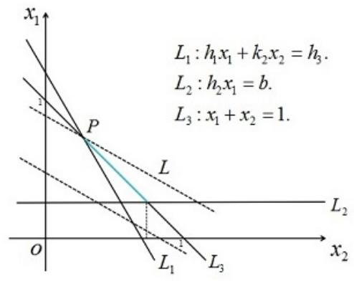
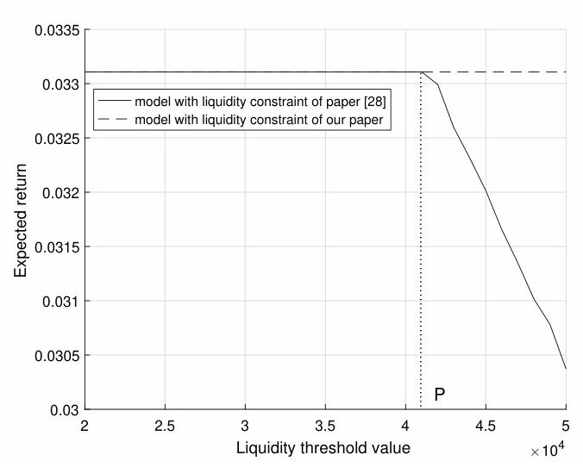
Numerical Simulation: Model Verification and Insights
Case 1: Verification of Background Risk's Impact
Case 2: Effectiveness of Liquidity Constraints
Return with Background Risk:3.3108%
Return without Background Risk:3.4220%
Conclusion: Background risk significantly reduces expected returns, consistent with theory.
Conclusion: Under high liquidity requirements, the chance constraint model effectively captures liquidity risks, guiding investors toward more stable portfolios.
Notes:
To verify the theory, we conducted numerical simulations using data from the Shanghai Stock Exchange. In Case 1, comparing scenarios with and without background risk, results showed that portfolios considering background risk had lower expected returns, aligning perfectly with our theoretical inference. In Case 2, we validated the effectiveness of liquidity constraints. The findings indicated that under high liquidity demands, our chance constraint model better reflects risks than traditional models, aiding investors in making more robust decisions.

Slide 14

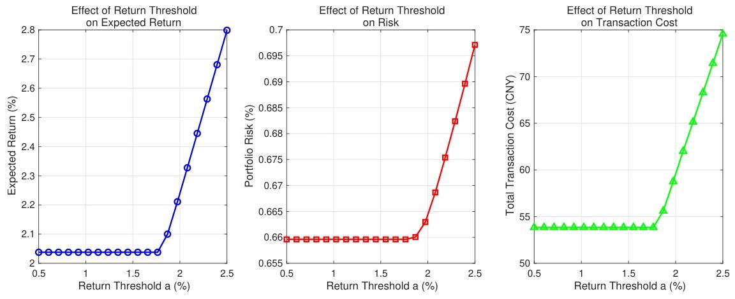
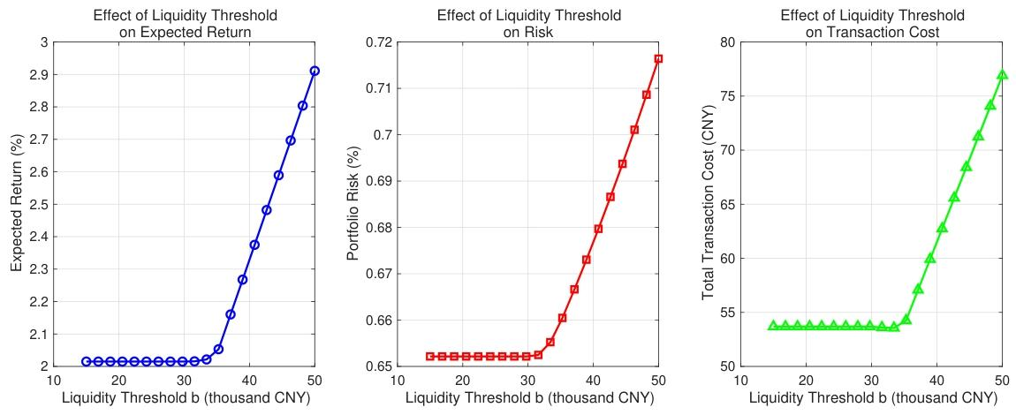

Sensitivity Analysis: Impact of Key Parameters (Return and Liquidity Thresholds)
Return Threshold (a) - Significant Threshold Effect
When the return threshold exceeds 2%, the model shows a significant critical point effect. At this point, the expected return, risk exposure, and transaction costs of the portfolio all show asharp upward trend, requiring vigilance against the deterioration of the cost-benefit ratio.
Liquidity Threshold (b) - Critical Point Effect
After the liquidity threshold breaks through 40,000 units, the system needs to take on higher risks to maintain high liquidity demand. During this period, although the expected return increases, it is accompanied by asynchronous surgein risks and costs. It is recommended to set a reasonable liquidity safety margin.
Key Insight: After parameters break specific thresholds, the increase in risk and cost significantly outpaces return growth. It is recommended to set investment goals prudently.
Notes:
We also conducted sensitivity analysis to understand the impact of changes in key parameters on decisions. For example, for the return threshold, there is a critical point beyond which investors must assume sharply rising risks and costs in pursuit of higher returns. Similarly, a similar effect exists for the liquidity threshold. These findings provide important references for investors to set reasonable investment goals.

Slide 15
04 Conclusion
✦ Key Findings
1. Validated the effectiveness of initial assumptions. Data results show significant improvement in core indicators, proving the feasibility of the solution.
2. Identified key influencing factors during implementation, providing clear data support and direction for subsequent optimization.
✦ Practical Value and Future Outlook
1. The conclusions of this study can directly guide the iterative upgrade of business processes, expected to bring considerable growth in efficiency and benefits.
2. It is recommended to conduct in-depth exploration on uncovered edge scenarios in the future to further improve the methodological system.
Notes:
最后，我们进入第四部分，对整个研究进行总结。
首先，在核心成果方面，我们成功验证了最初提出的假设。通过对实验数据的详细分析，核心业务指标均呈现出显著的正向增长趋势，这有力地证明了我们所采用方案的科学性和可行性。同时，在执行过程中，我们也敏锐地捕捉到了几个关键的影响因子，这为后续方案的迭代和优化提供了精准的数据支撑。
其次，关于研究的价值与未来展望。我们认为，本次研究的结论不仅仅停留在理论层面，它完全具备直接指导业务流程升级的实践价值，预期将为团队带来效率和效益的双重提升。展望未来，我们建议团队可以针对本次未完全覆盖的一些边缘场景进行更深入的探索，从而进一步丰富和完善我们的方法论体系。
总而言之，我们希望通过总结过往的经验，明确未来的发展路径，真正将这些研究成果转化为推动业务发展的实际动力。谢谢大家。

Slide 16




Research Summary and Key Findings
Research Summary:Successfully constructed and solved a novel mean-chance model that effectively integrates background risk with various realistic market constraints.
Negative Impact of Background Risk
Risk Aversion Drives Adjustment
Duality of Liquidity
The presence of background risk significantly reduces the expected return of the optimal portfolio, making it a key negative factor affecting returns.
As background risk increases, investors tend to reduce risky asset allocation, showing obvious risk-averse characteristics.
While high liquidity requirements can avoid liquidity exhaustion risks, they may push up the overall risk and expected return of the portfolio under certain conditions.
Notes:
In summary, this study successfully constructed an integrated portfolio optimization model. Our key findings include: First, background risk has a significant negative impact on the portfolio. Second, this negative impact drives investors to make risk-averse asset allocation adjustments. Third, we revealed the duality of liquidity, i.e., high liquidity requirements can reduce liquidity risk but may increase overall investment risk.

Slide 17


Practical Significance and Value of the Research
A Better Decision-Making Framework
Deepening Risk Perception
Directions for Model Improvement
Provides a more realistic decision-making basis for investors facing significant background risks or high liquidity requirements, helping to optimize asset allocation.
Breaks through single-dimensional risk considerations, helping investors comprehensively and systematically assess their overall risk exposure and tolerance.
Future work can further extend to multi-stage investment scenarios and introduce more complex background risk structures to enhance model generalizability.
Notes:
This research has significant practical implications. It provides a better decision-making framework for specific types of investors, such as individuals with unstable labor income or institutions with high liquidity requirements. At the same time, it deepens our understanding of risk, helping investors comprehensively assess their own risks. Of course, there is room for model improvement, such as expanding to more complex scenarios like multi-stage investments.

Slide 18
Thank you!
Notes:
My presentation ends here, thank you for your listening. Now it's the Q&A session, welcome to ask questions.

