Slide 1
PV-Powered EV Charging in Zero-Carbon Communities: Subsidy Effects and Chaotic Dynamics
Yuxin Liu
College of Management and Economics of Tianjin University

Slide 2
General Guideline
Slide Format: 16:9
File Naming Convention:
PowerPoint should be named "Paper ID".pptx
Recommended Contents of Your Presentation
Introduction and Purpose
Hypothesis/Research Method and Main Process
Results and Analysis
Conclusion

Slide 3
Contents
01
Introduction
02
Scenario and Models
03
Results and Discussions
04
Conclusions

Slide 4
1. Introduction

Slide 5


1.1 Background
Tranditional Distributed Renewable Sources
Generation is time-dependent and unstable.
Overgeneration, curtailment.
Low utilization efficiency.
Zero-carbon Communities
Enabled by critical technologies: virtual power plant.
Prosumer buildings
Smart Energy Management Systems
Sources (PV, wind turine, Fuel generator) / Grid / Load / Storage
Fig. 1 Located in Bicester, Oxfordshire, the Elmsbrook Eco-Town

Slide 6
1.2 Purposes
Motivation
(1) Economic feasibility of ZCCs under declining feed-in tariffs (FiT)
(2) Feasibility of peer-to-peer (P2P) green electricity trading: evidence from ZCC–EV charging pile interactions
(3) Complete elimination of the carbon footprint from EV electricity supply
issues
(1) Economic feasibility & operational scenario complexity
Declining Feed-in Tariff (FiT) reduces profitability of surplus PV
Necessitate P2P green electricity trading for Profitability (e.g., EV charging piles)
Research question 1: How to select optimal operational scenarios & pricing strategies under multi-factor coupling?

Slide 7
1.2 Purposes
issues
(2) Effectiveness of several types of fiscal subsidies
PV equipment subsidies (ZCC operator or PV supplier ) \ Green electricity trading subsidies (ZCC operator or EV owners)
Subsidies ≠ always effective
Spillover effects
Research Question 2: Which subsidy type yields the highest marginal social benefit?
(3) System Stability & Chaotic Dynamics
Participants: Information perception delay, decision adjustments based on bounded rationality
Potential chaos in supply chains
Research Question 3: How do decision adjustment speeds affect system stability?

Slide 8
2. Scenario
and Models

Slide 9
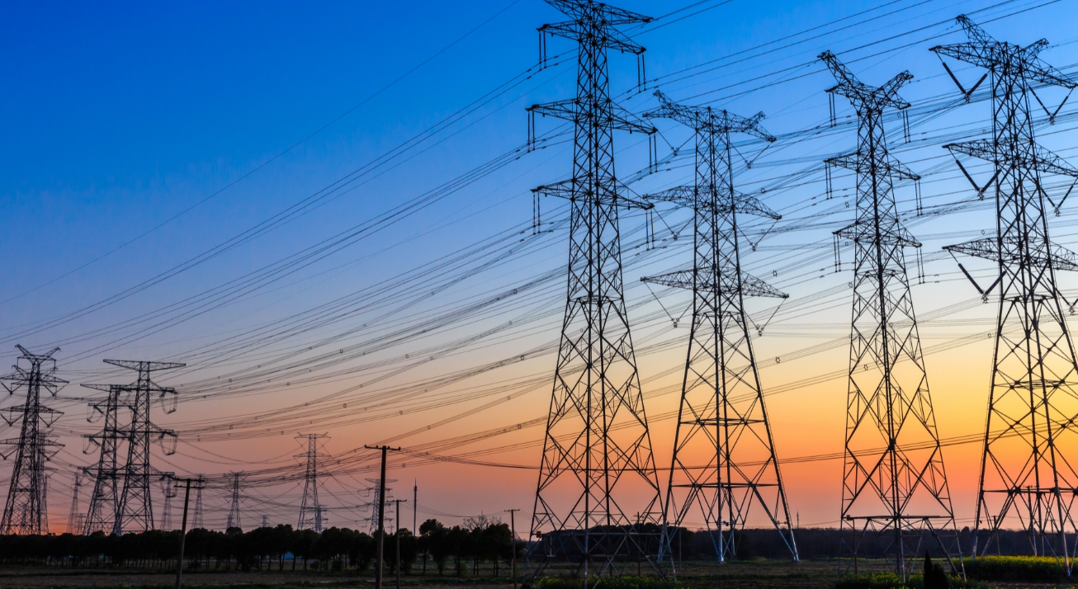

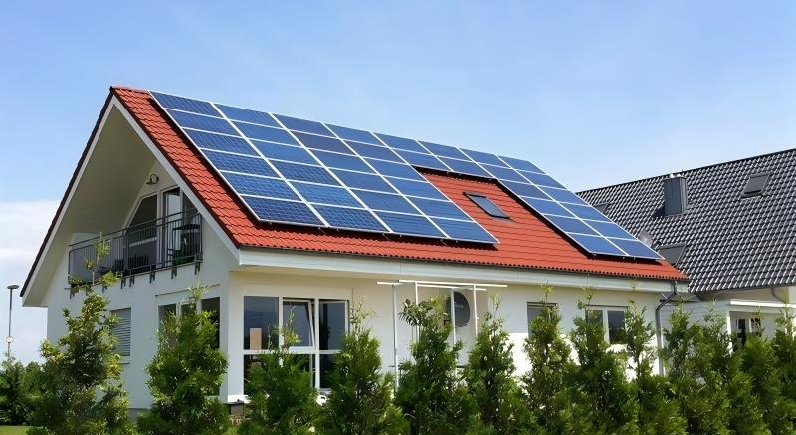
Scenario Description
Grid Utility
PV Supplier
ZCC Operator
Supplies backup power and purch-ases surplus electricity via FiT from ZCC.
Manufactures and sells photovolta-ic systems to ZCC operators
Installs PV systems and manages local energy generation and distribu-tion

Slide 10
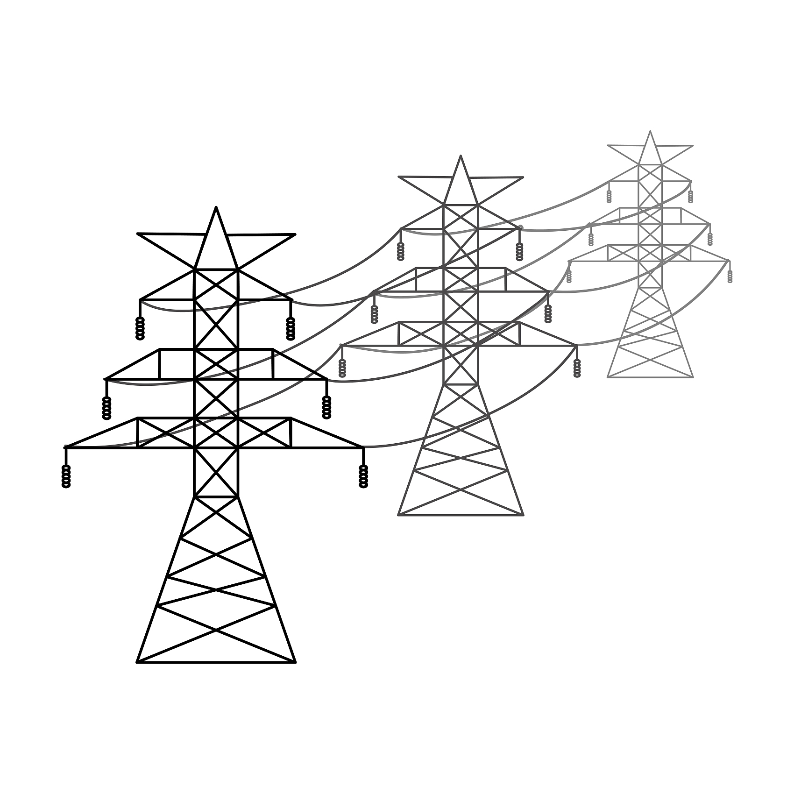



Scenario Description
Scenario BN
Scenario B
Grid utility
ZCC Operator
Local Loads
PV Supplier
Material Flow
Electricity Flow

Slide 11




Scenario Description
Scenario GEN
Scenario GE/GEM
Grid utility
ZCC Operator
Local Loads
PV Supvplier
Charging Piles
Material Flow
Electricity Flow

Slide 12
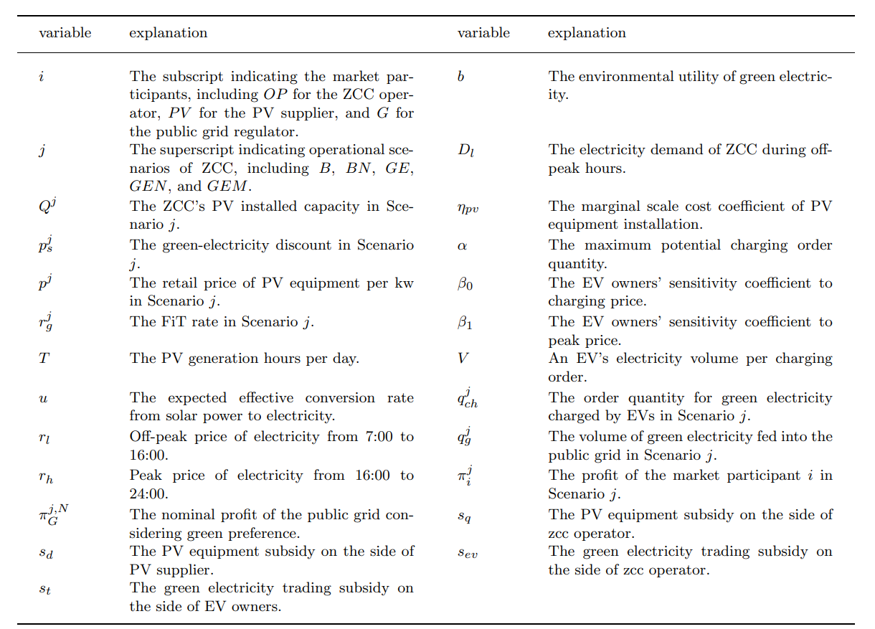
Models

Slide 13
Models
Scenario BN
The profit decision model of the ZCC operator:
Scenario B
Feed into the utility grid = PV generation - Regional loads
The profit decision model of the ZCC operator:

Slide 14
Models
The demand functions for EV charging in Scenario GE/GEN/GEM
Scenario GE/GEM
If , Then Scenario GE is transformed to GEM, where .
Feed into the utility grid = PV generation - Regional loads - Supply for charging piles
The profit decision model of the ZCC operator:

Slide 15
Models
Scenario GEN
PV generation = Regional loads + Supply for charging piles
The profit decision model of the ZCC operator:

Slide 16
Models
Scenario j: $j∈\{BN,B,GEN,GE,GEM\}$
The profit decision model of the grid utility:
The profit decision model of the PV supplier:

Slide 17
Models
Scenario j: $j∈\{BN,B,GEN,GE,GEM\}$
The profit decision model of the grid utility:
The profit decision model of the PV supplier:

Slide 18
Models
Fiscal Subsidy Multiplier (FSM):
The contribution of each unit of fiscal subsidy investment to the grow-th of a certain entity's income.

Slide 19
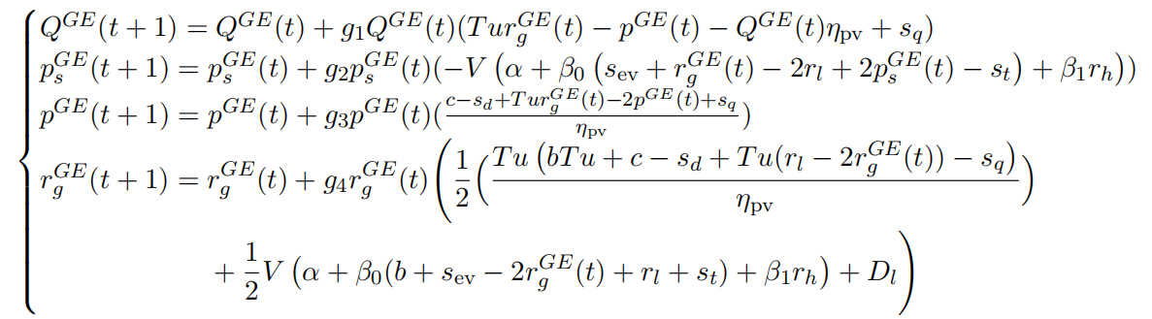
Models
Dynamic adjustment of decision-making based on bounded rationality
-Incomplete information
-Perceptual delay

Slide 20
3. Results and
Discussions

Slide 21
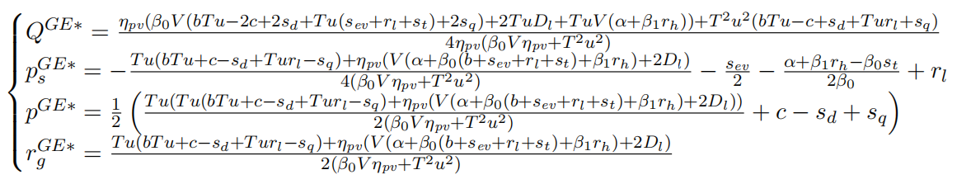
Static Decision Equilibrium

Slide 22
Static Decision Equilibrium
Proposition 1: The decision equilibriums in Stackleberg game for
all stakeholders are given as follow:

Slide 23
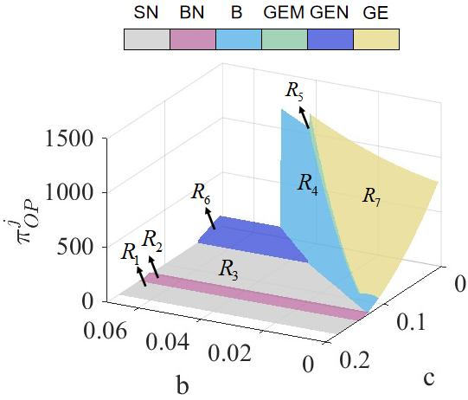
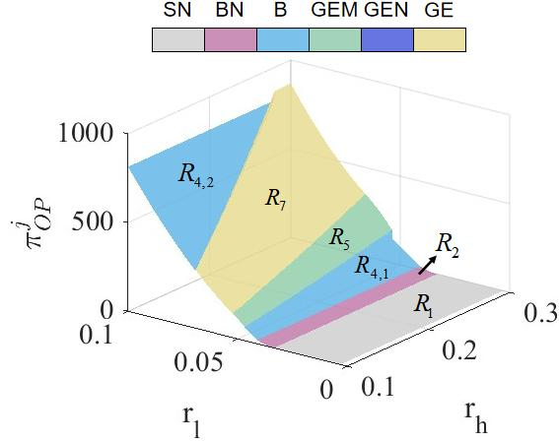
Robustness Analysis of Profitability
Fig. 2 The ZCC operator’s profitability considering varying factors.

Slide 24
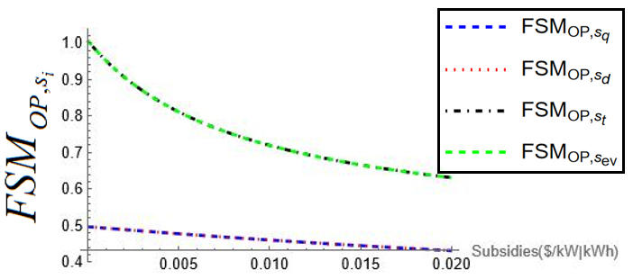
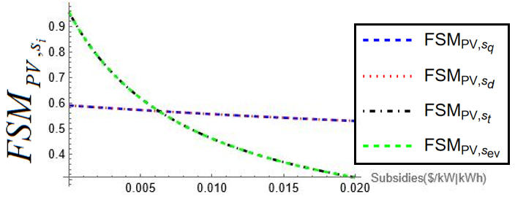
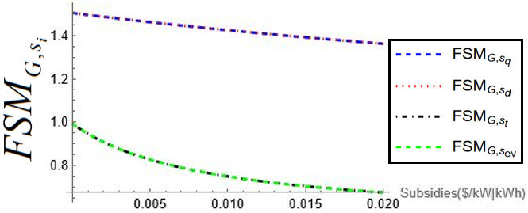
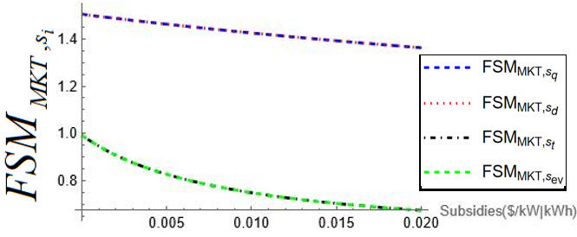
Analysis on FSM
Fig. 3 Fiscal subsidy multiplier curves.

Slide 25
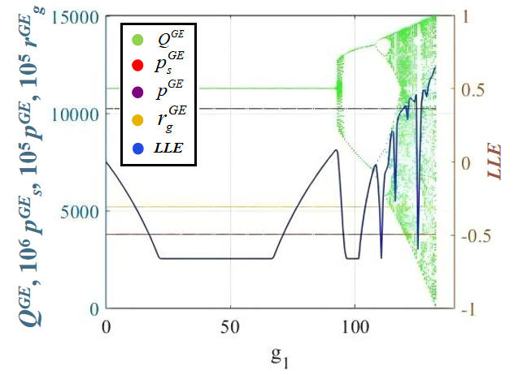
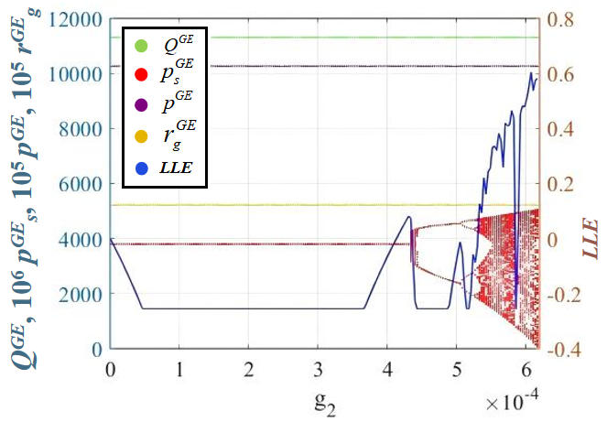
Bifurcation and Chaos
(a) $g_{2}=1e−4,g_{3}=g_{4}=5e−6 (b) g_{1}=10,g_{3}=g_{4}=5e−6$

Slide 26
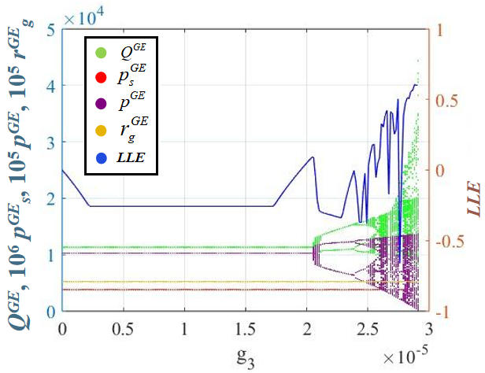
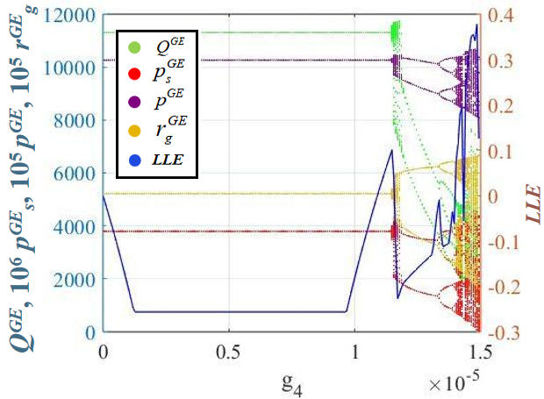
Bifurcation and Chaos
(c) $g_{1}=10,g_{2}=1e−4,g_{4}=5e−6 (d) g_{1}=10,g_{2}=1e−4,g_{3}=5e−6$
Fig. 4 The bifurcation diagrams and LLE curves on $g_{i}$

Slide 27
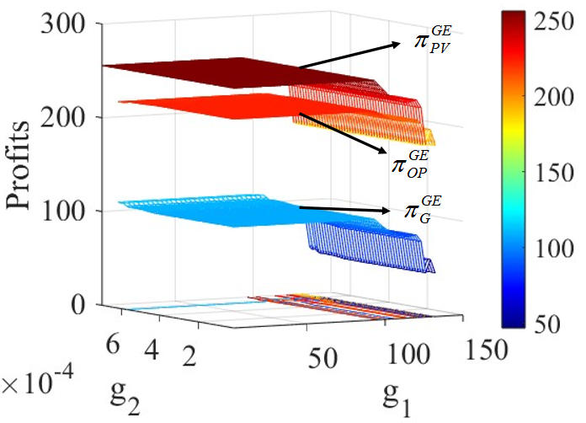
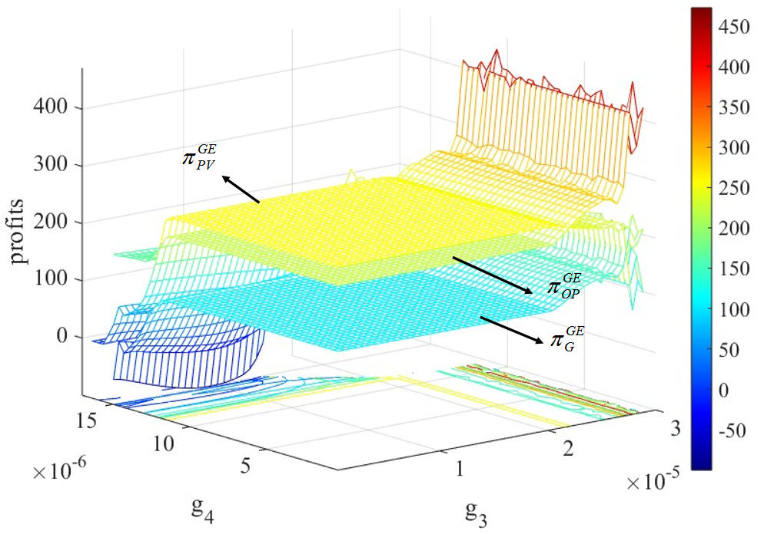
Bifurcation and Chaos
Fig. 5 The average profit of the stakeholders in regard with $g_{i}$

Slide 28
4. Conclusions

Slide 29
PV cost and environmental utility of green electricity jointly determine ZCC operation mode and profitability.
1
2
ZCC–EV cooperation outperforms independent operation under most feasible conditions. However, a small TOU price gap leads to independent operation more advantageous.
3
PV-equipment subsidies outperform consumption subsidies in overall market efficiency
Aggressive decision adjustments trigger chaos and reduce long-term system profitability
4

